Slide 1

2025 CHNA/CHA Work Group
Ad Hoc Priority Selection Meeting
April 24, 2025

Slide 2

Agenda
Introductions & Housekeeping
Today’s Meeting Goals:
  Review of LIHC primary data
  Selection of regional Prevention Agenda Priorities
Next Steps
Notes:
Here’s today’s meeting agenda. The goal of today’s meeting is to discuss the LIHC’s primary data sets and select our regional PA priorities as a group

Slide 3

Welcome & Introductions
Thank you for joining us!
Please share your name, role, and organization with the group.
CHAS
Notes:
Letplease start with introductions. I’ll call on folks as I see them.’s

Slide 4
Housekeeping
All meeting materials on LIHC website: https://www.lihealthcollab.org/member-resources/meeting-info/2025-chnacha-work-group
Work group meets on the second Wednesday of every month at 2 PM
Notes:
Some housekeeping, all of our meeting materials are on the LIHC website here

Slide 5
LIHC Primary Data
2024 CBO Survey Data
2025 CBO Key Informant Interview Qualitative Analysis
2024 CHAS Data
Preliminary 2025 CHAS Data
Notes:
Hopefully you had a chance to review these primary data sources prior to today’s meeting, but we’ll be going over highlights together today

Slide 6
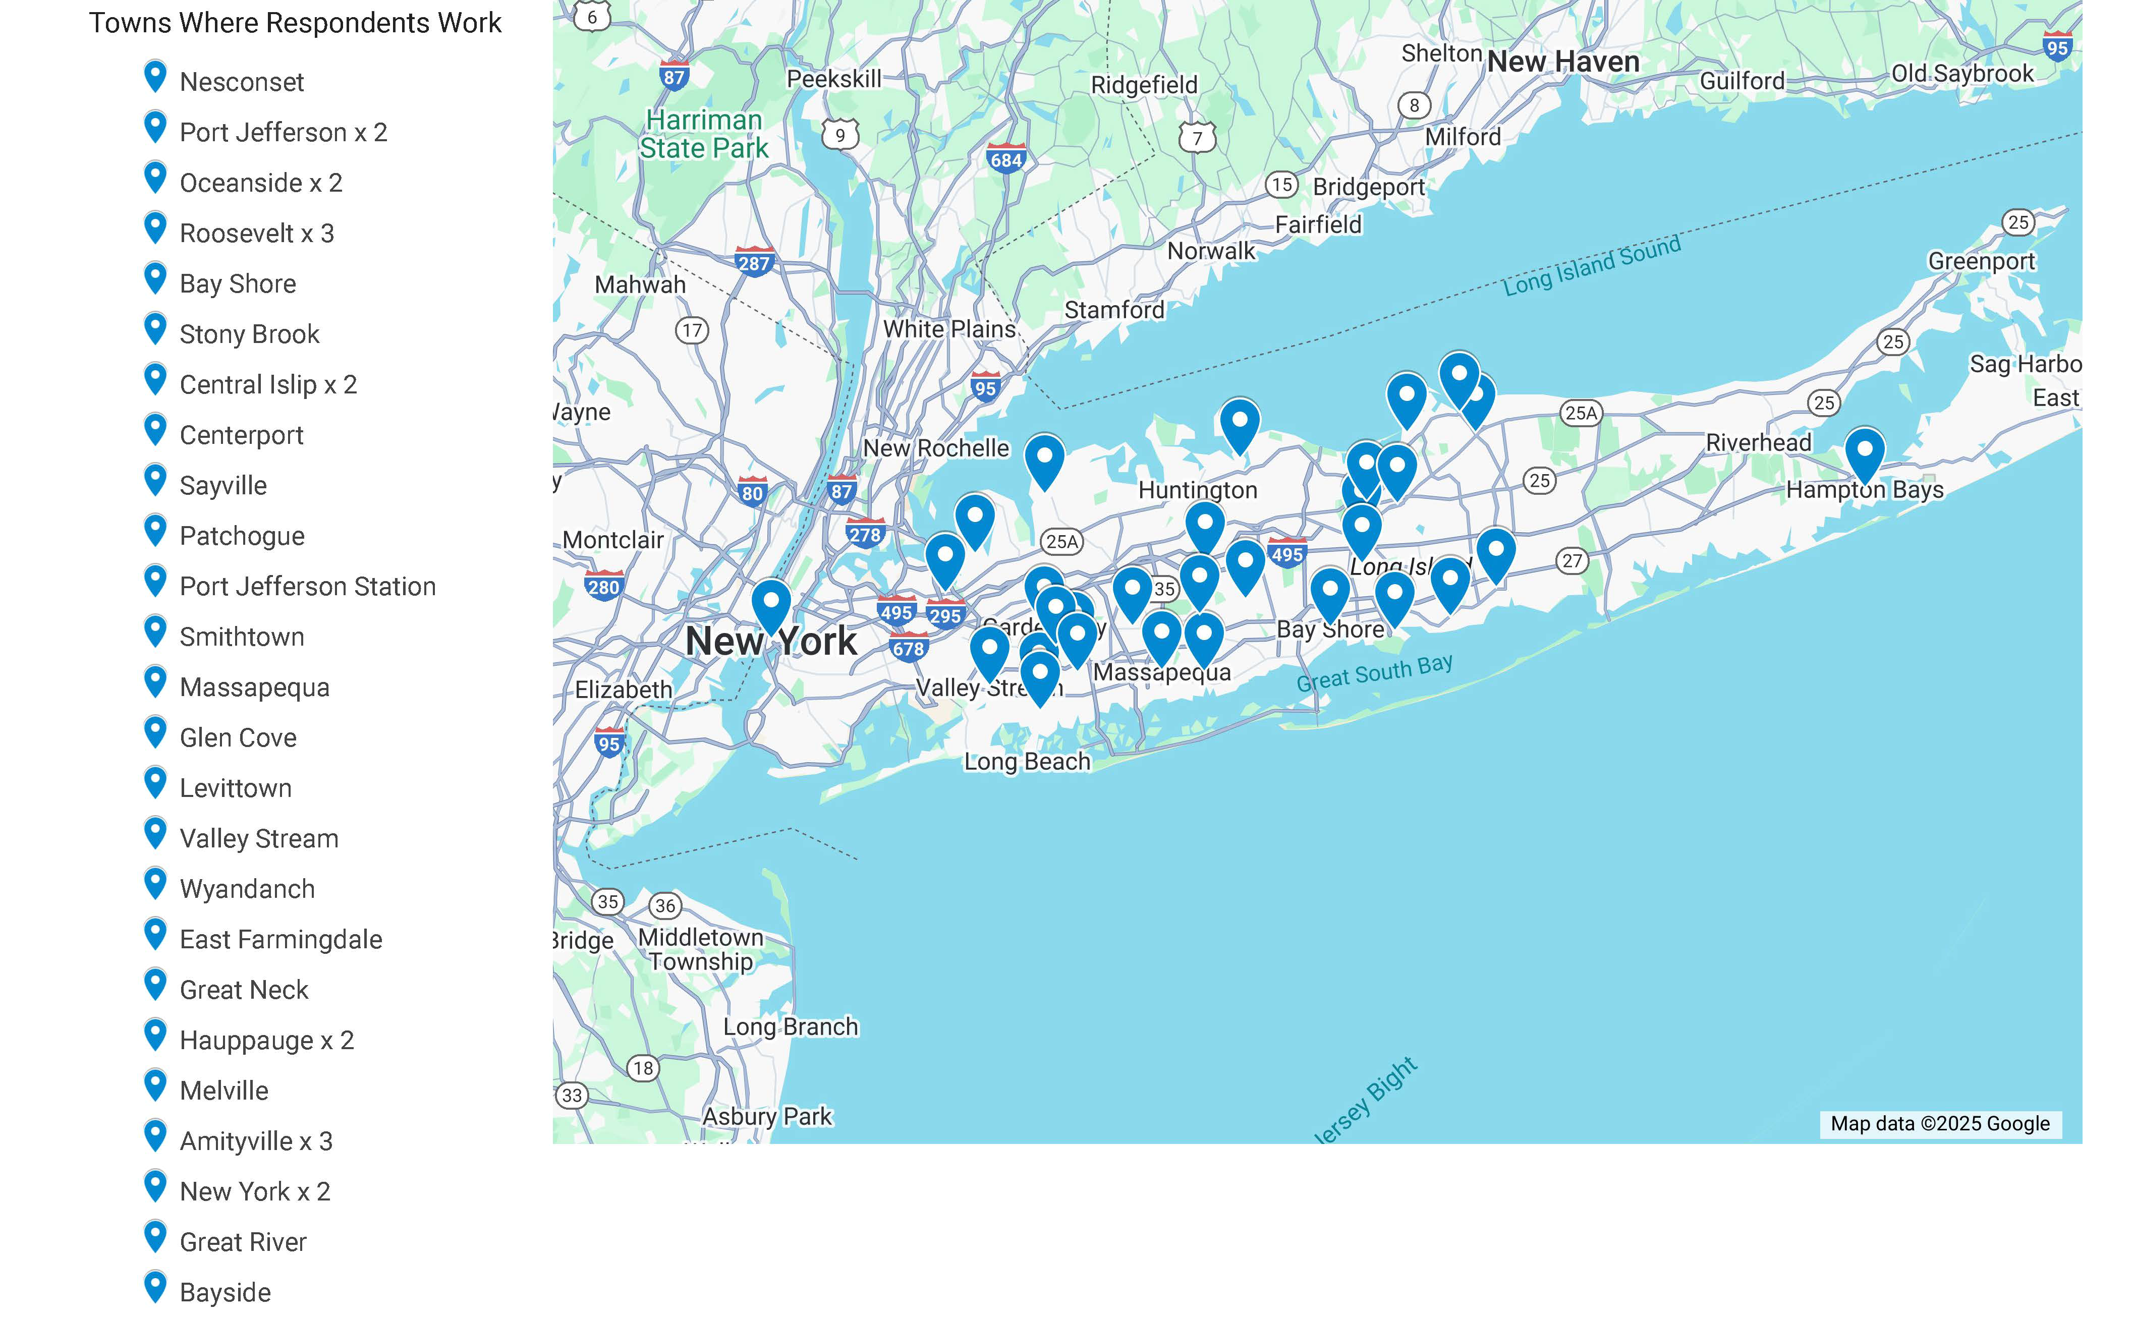
2024 CBO Survey Data
Nassau County Total: 18
Suffolk County Total: 24
Both Counties: 3
Queens/Unspecified: 3
Notes:
The 2024 CBO Survey was deployed in the later part of 2024
As you’ll recall, we also used this to recruit interviewees
We had 18 respondents who serve Nassau, 24 respondents who serve Suffolk, and 3 folks said their org serves both counties

Slide 7
2024 CBO Survey Data
Notes:
The first question asked respondents to select one of the HRSN buckets from the PA
Mental wellbeing and substance use was the front runner, followed by economic wellbeing
Safe and healthy communities tied with health insurance coverage/access to care
Healthy children tied with prek-12 student success and edu attainment

Slide 8
2024 CBO Survey Data
Notes:
Respondents said the top 3 biggest health and or social problems for the folks they serve are housing instability, anxiety/stress, and poverty

Slide 9
2024 CBO Survey Data
Notes:
Respondents feel affordable housing, access to community services and support, and job opportunities are the top 3 most helpful interventions to improve the health problems of the folks they serve

Slide 10
2024 CBO Survey Data
Notes:
Most respondents said the populations they serve do experience barriers to healthcare

Slide 11
2024 CBO Survey Data
Notes:
They feel those barriers are primarily misinformation/lack of health literacy and fear/hesitancy
Language barriers and not knowing how to find providers are up there too
Followed by no insurance/unable to pay for care and lack of availability of providers/appts

Slide 12
2024 CBO Survey Data
Notes:
Respondents feel the top 3 health screenings/services needed for their populations are anxiety/stress management, blood pressure, and nutrition

Slide 13
2024 CBO Survey Data
Notes:
Respondents said most of their clientele get their health information from health professionals, family/friends, and the internet

Slide 14
2024 CBO Survey Data
Notes:
Question 8 was open-ended, so this chart represents key themes identified by qualitative analysis
The top three themes were education, access to healthcare, and access to resources

Slide 15
2025 CBO Key Informant Interview Qualitative Analysis
From February 7, 2025 through April 8, 2025, the LIHC conducted 23 interviews with 28 individual informants from 23 different organizations. Interviews were conducted virtually and transcribed via Zoom. All interviewees were asked the same three open-ended questions. Organizations represented:
Adelphi NY Statewide Breast Cancer Hotline & Support Program
Age Friendly Glen Cove
American Lung Association
Cancer Services Program of Suffolk
Catholic Charities
Central Nassau Guidance
Cornell Cooperative Extension of Suffolk
Docs for Tots
Glen Cove CDA & IDA
Hands Across Long Island (HALI)
Health & Welfare Council of LI (HWCLI)/HEALI/SCN
Latina Sisters
Leukemia and Lymphoma Society
Long Island Coalition for the Homeless
Nassau-Suffolk Hospital Council
New York Coalition for Transportation Safety
Pronto Long Island
STEMM & Cancer Health Equity Foundation
Stony Brook Cancer Center
The g6pd Deficiency Foundation
The Society of St. Vincent de Paul LI
Western Suffolk BOCES
Wyandanch Community Center / Town of Babylon
Notes:
We received feedback via interview from 28 individuals representing 23 different organizations
Interviews were recorded, transcribed, and qualitatively analyzed using Atlas.TI
Instead of grounded theory, we employed deductive thematic analysis by using a pre-determined set of codes that directly correlate to the 24 priorities outlined by the NYS Prevention Agenda
Coders chose to employ this method instead of grounded theory given the analysis’ purpose to help hospitals and health departments choose regional priorities from the Prevention Agenda as a group by consensus
Obviously, the PA priorities can be quite specific, so in our full report, we include descriptions of what each code entails and how we interpreted each priority in our coding

Slide 16
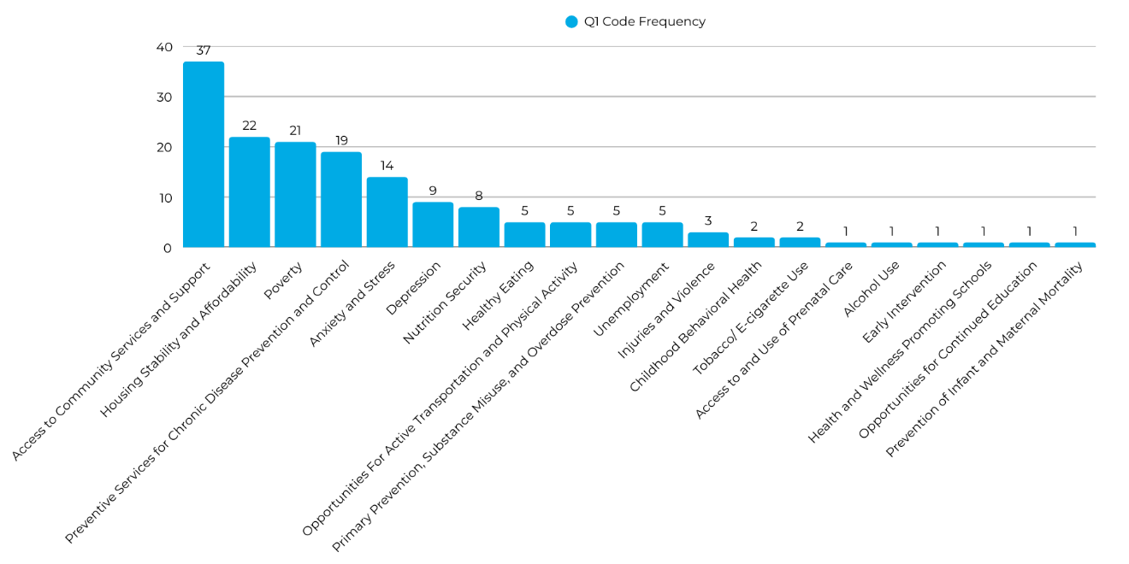
2025 CBO Key Informant Interview Qualitative Analysis
Question 1: Biggest Health and/or Social Problems
In your experience, what are the biggest health and/or social problems for the people/community you serve?
Question 1 Code Distribution
Notes:
When asked about the biggest health or social problems for the folks they serve, the top 3 themes were
Access to Community Services and Support, Housing Stability and Affordability, and Poverty
Access to Community Services and Support includes problems related to: o Access to healthcare as well as community services o Workforce shortages o Workforce’s lack of cultural competency and humility o Appointment unavailability and long wait times o Transportation infrastructure o Language barriers o Cultural beliefs o Gaps in services o Public difficulty navigating health and community services o Public difficulty navigating their own health insurance coverage o Lack of awareness of services o Lack of mental health services to meet the community’s needs o Uninsurance and/or underinsurance
Housing Stability and Affordability includes problems related to: o The need to prioritize rent over accessing healthcare o Unaffordable cost of housing o Being unhoused or transient
Poverty includes problems related to: o Every instance where the issue of income or cost was a social problem for the populations served o Unaffordability of health insurance and/or copays o Unaffordability of healthcare o Unaffordability of medication o Unaffordable cost of living o Individuals who work or have multiple jobs but remain in poverty o Prioritization of basic needs over healthcare services due to financial constraints

Slide 17
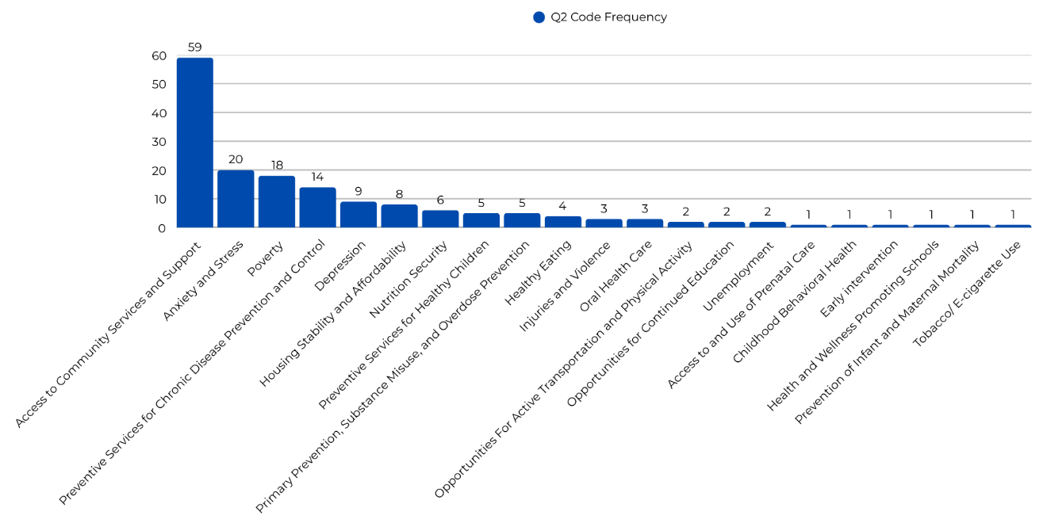
2025 CBO Key Informant Interview Qualitative Analysis
Question 2: Biggest Barriers to Care
In your professional experience, what is the biggest barrier to healthcare or social services experienced by the people/communities you serve?
Question 2 Code Distribution
Notes:
When asked about biggest barriers to care, the top 3 themes among interviewee responses were Access to Community Services and Support, Anxiety and Stress, and Poverty
Access to Community Services and Support includes barriers related to: o Access to healthcare services as well as community services o Access to preventive health screenings o Appointment/provider unavailability o Awareness of services o Continuum of care o Insurance status, underinsurance, uninsurance o Knowledge and navigation of health insurance o Knowledge and navigation of the health system o Lack of health literacy o Lack of trauma-informed workforce o Language barriers o Limitations of insurance coverage o Long wait times o Stigmatization of mental illness and substance use as a barrier to services o Transportation barriers o Workforce lack of cultural competence and humility o Workforce shortages
Anxiety and Stress includes barriers related to: o Anxiety/fear surrounding seeking healthcare for underserved populations including undocumented, LGBTQIA+ communities o Anxiety about one’s own lack of health literacy o Anxiety and stress related to cost of living o Anxiety surrounding an individual’s health status, or the health status of their loved ones o Distrust of providers and the healthcare system
Poverty includes barriers related to: o Unaffordability of health insurance and/or copays o Unaffordability of healthcare o Unaffordability of medication o High cost of living o Low wages and low-income o Medicaid eligibility income limits o Working or having multiple jobs but remaining in poverty

Slide 18
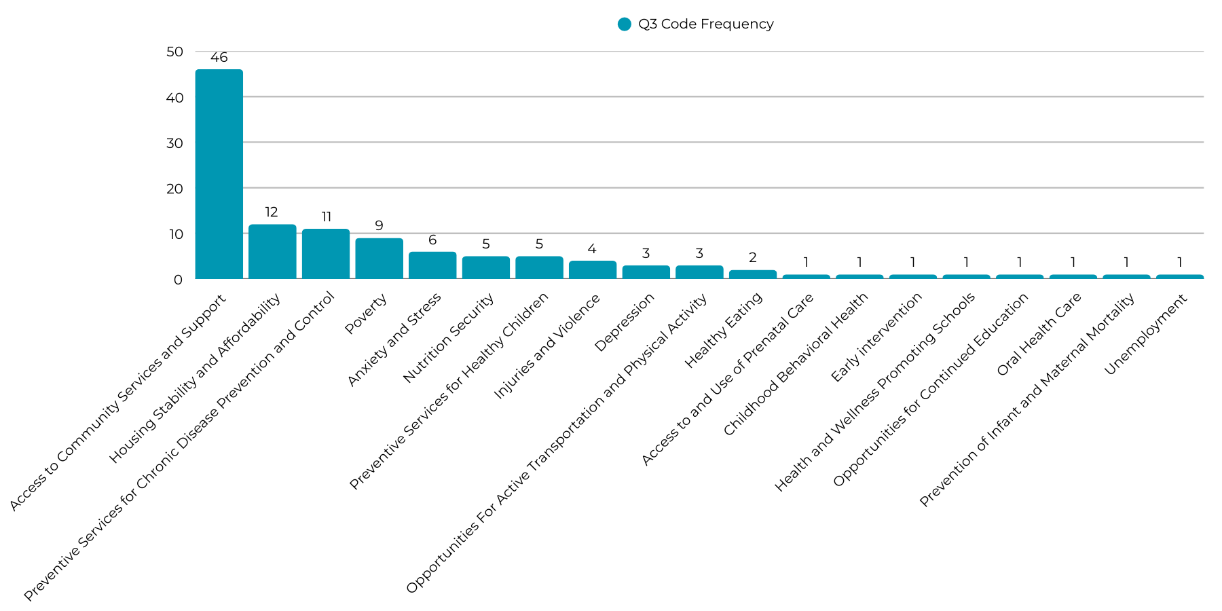
2025 CBO Key Informant Interview Qualitative Analysis
Question 3: Most Helpful Interventions
In your professional opinion, what interventions (screenings, resources, educational programs, etc.) would be most helpful to improve the health of the people/communities you serve?
Question 3 Code Distribution
Notes:
Top themes among interviewee responses about the most helpful interventions were Access to Community Services and Support, Housing Stability and Affordability, and Preventive Services for CD Prevention and Control
Access to Community Services and Support includes interventions related to: o Improving access to healthcare services as well as community services o Providing onsite daycare options to increase access to healthcare o Increased awareness about emergency Medicaid o Reducing language barriers to care o English classes for non-native speakers o Increased multilingual providers o Flexible provider hours outside of traditional business hours o Improved public health and healthcare policy o Improved coordination of care among providers o Improved technological healthcare infrastructure o Increased appointment availability o Increased awareness of healthcare facilities and services o Increased inclusivity for all patient populations o Increased integration between health and social services o Increased points of healthcare access; delivering healthcare to underserved populations where they are o Increased access to health insurance o Increased telehealth services o Increased trained community health workforce to align with the provision of SDOH interventions o Increased visibility of multilingual services o Increasing health equity o Streamlining the patient experience o Public education about digital literacy o Public education about health literacy o Public education about navigation of the healthcare system o Public education about traffic, pedestrian, and bike safety o Securing additional funding for services and programs o Smoother continuum of care o Stable federal funding o Street medicine programs and interventions o Transportation services o Workforce education about best practices o Workforce education about cultural competency and humility o Workforce education about comorbidities o Workforce education about discharge planning and securing social services upon discharge, more complete discharge planning o Addressing funding challenges by tapping into wealthy populations o Increased transportation options for disabled populations o Increasing the number of providers who take Medicaid, particularly specialists o Subsidized healthcare for low-income populations
Housing Stability and Affordability includes interventions related to: o All interventions related to the unhoused population o Programs to help patients secure housing o Housing First models of assistance for unhoused populations o Minimizing stringent eligibility requirements for housing programsSafe transitional and emergency housing options o Reducing housing barriers to healthcare, how lack of address excludes folks from getting care o Subsidized housing for medically frail populations o More mobile shower units
Preventive Services for Chronic Disease Prevention and Control includes interventions related to: o Education about chronic disease self-management o Increasing adult access to vaccinations

Slide 19
2024 CHAS Data
997 surveys were collected between January 1st and December 31st, 2024
363 Nassau County respondents
509 Suffolk County respondents
125 respondents did not belong to either Nassau or Suffolk County and were not included in the analysis

Slide 20
2024 CHAS Data
When asked: What are the biggest ongoing health concerns in THE COMMUNITY WHERE YOU LIVE?

Slide 21
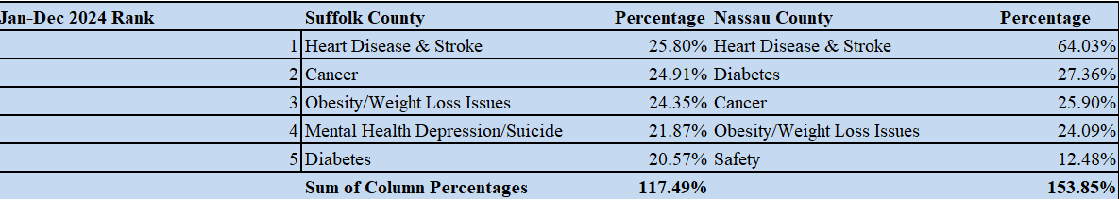
2024 CHAS Data
2. When asked: What are the biggest ongoing health concerns for YOURSELF?

Slide 22
2024 CHAS Data
3. When asked: What prevents you and your family from getting medical treatment?

Slide 23
2024 CHAS Data
4. When asked: Which is MOST needed to improve the health of your community?

Slide 24
2024 CHAS Data
5. When asked: What health screenings or education/information services are needed in your community?

Slide 25
2024 CHAS Data
6. Finally, when asked: Where do you and your family get most of your health information?

Slide 26
Prelim 2025 CHAS Data
Data was collected between January 1 – March 31, 2025
During this time, a total of 27 community members provided a response, including 25 in English and two (2) in Spanish

Slide 27
Prelim 2025 CHAS Data
Notes:
Reminder, these are not weighted and simply represent the frequency of each answer among survey respondents

Slide 28
Prelim 2025 CHAS Data
Notes:
Respondents feel the 3 biggest ongoing health/social concerns for the community where they live are depression, anxiety/stress, and obesity/weight loss issues

Slide 29
Prelim 2025 CHAS Data
Notes:
Respondents feel the 3 biggest ongoing health/social concerns for themselves are anxiety/stress, poverty, and depression/women’s health tied for third place

Slide 30
Prelim 2025 CHAS Data
Notes:
Respondents feel their top 3 barriers to medical treatment are lack of availability of providers/appointments, no insurance/unable to pay for care, and prior negative experiences
Followed by misinformation/lack of health literacy

Slide 31
Prelim 2025 CHAS Data
Notes:
Respondents feel health education programs, affordable housing, and access to healthier food is most needed to improve the health of their community

Slide 32
Prelim 2025 CHAS Data
Notes:
Survey takes said services and screenings related to anxiety/stress management, nutrition, and weight loss programs / cancer are most needed in their community

Slide 33
Prelim 2025 CHAS Data
Notes:
Respondents mostly get their health information from doctors, followed by the internet, then family/friends

Slide 34
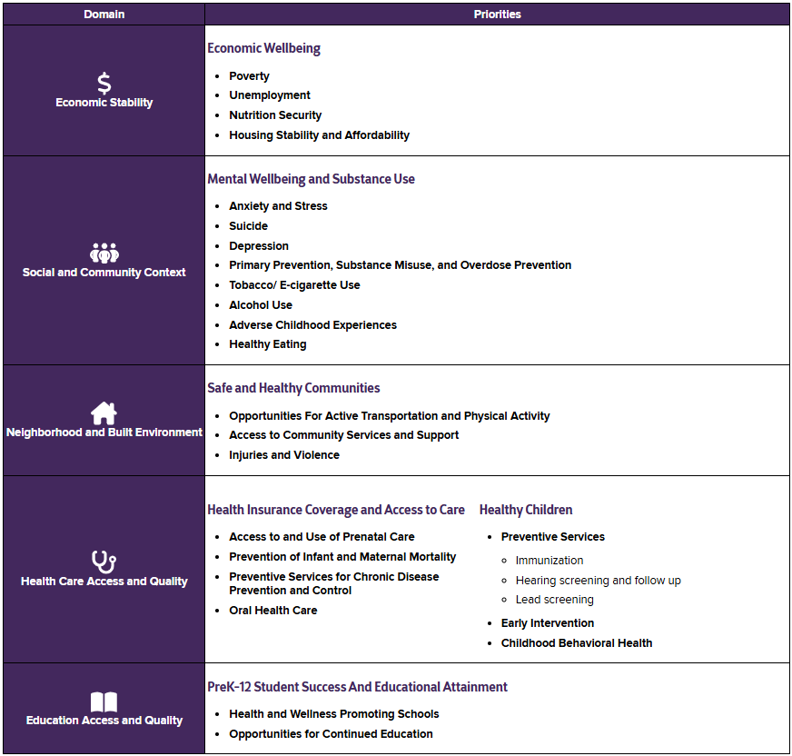
2025-2030 PA Priorities
New PA Priorities
As a group, we will now vote on 3 from list of 24, informed by CHNA/CHA findings
Let’s vote
Notes:
Select 3 from list of 24
Not presented as “actionable” items but are simply topics (such as Unemployment, Healthy Eating, Poverty, etc.).
Derived from the five social determinant of health domains from Healthy People 2030 (Economic Stability, Social and Community Context, Neighborhood and Built Environment, Health Care Access and Quality, Education Access and Quality)
Priorities grouped by a category descriptor, also informed by the SDH domains
Selection of at least one of the following social determinants of health is strongly encouraged:
Poverty
Unemployment
Nutrition Security
Housing Stability and Affordability
Health and Wellness Promoting Schools
Opportunities for Continued Education

Slide 35
Next Steps
To come in late June:
    CHNA/CHA regional report template
    Excel Workplan with all LIHC programs/metrics to come
Next Monthly Meeting: Wednesday, May 14, 2025, at 2 PM

Slide 36
Discussion, Questions, etc.
Questions, comments, concerns?
Adjournment

